Slide 1
SOLAR ENERGY COMPANY
PITCH DECK INFOGRAPHICS
Here is where this template begins
SOLAR ENERGY - SOLAR ENERGY - SOLAR ENERGY - SOLAR ENERGY - SOLAR ENERGY - SOLAR ENERGY

Slide 2
ABOUT SOLAR ENERGY COMPANY PITCH DECK INFOGRAPHICS
This template contains an assortment of complementary infographic resources for the Solar Energy Company Pitch Deck presentation
These infographics are adapted to the style of the aforementioned presentation, so you can insert them easily and have them completely integrated at once. You just need to do the following:
Select the element that you want to copy
Right-click and choose “Copy”
Go to the slide where you want the element to appear
Right-click and choose “Paste”

Slide 3
SOLAR ENERGY INFOGRAPHICS
JUPITER
VENUS
SATURN
MARS
Jupiter is the biggest planet
Venus has a nice name
Saturn is a gas giant with rings
Mars is very cold, not hot
01
02
03
04

Slide 4
SOLAR ENERGY INFOGRAPHICS
EARTH
01
Earth is the third planet from the Sun and the only one that harbors life in the Solar System
MERCURY
02
Mercury is the closest planet to the Sun and the smallest one
VENUS
03
Venus is the second planet from the Sun. It’s terribly hot, even hotter than Mercury

Slide 5
SOLAR ENERGY INFOGRAPHICS
JUPITER
It’s a huge gas giant
3/5
SATURN
Saturn has rings
4/5
MARS
Mars is made of basalt
5/5

Slide 6
SOLAR ENERGY INFOGRAPHICS
SATURN
EARTH
Saturn is not the only planet with rings
Earth is the only planet known to harbor life
JUPITER
VENUS
Jupiter is the biggest planet of them all
Venus is the second planet from the Sun
MARS
MERCURY
Despite being red, Mars is actually a cold place
Mercury is the smallest planet of them all

Slide 7
SOLAR ENERGY INFOGRAPHICS
01
02
03
04
JUPITER
VENUS
SATURN
MARS
Jupiter is a huge gas giant
Venus has a beautiful name
Saturn is a gas giant with rings
Mars is very cold, not hot

Slide 8
SOLAR ENERGY INFOGRAPHICS
1
3
SOLAR ENERGY
SATURN
JUPITER
Saturn is not the only planet with rings
Jupiter is the biggest planet of them all
2
MARS
Mars is actually a cold place, not hot

Slide 9
SOLAR ENERGY INFOGRAPHICS
EARTH
1
It’s the third planet from the Sun and the only one that harbors life in the Solar System
1
2
MERCURY
2
Mercury is the closest planet to the Sun and the smallest one
3
VENUS
3
Venus is the second planet from the Sun. It’s terribly hot, even hotter than Mercury

Slide 10
SOLAR ENERGY INFOGRAPHICS
SATURN
1
Saturn is not the only planet with rings
JUPITER
2
SOLAR ENERGY
Jupiter is the biggest planet of them all
MARS
3
Despite being red, Mars is actually a cold place

Slide 11
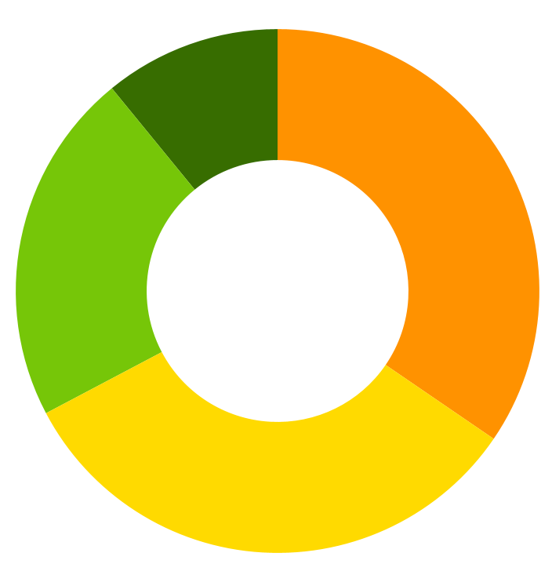
SOLAR ENERGY INFOGRAPHICS
MERCURY
VENUS
10%
35%
Mercury is the smallest planet
Venus has a beautiful name
JUPITER
MARS
25%
30%
Jupiter is a huge gas giant
Mars is full of iron oxide dust
Follow the link in the graph to modify its data and then paste the new one here. For more info, click here

Slide 12
SOLAR ENERGY INFOGRAPHICS
25%
50%
75%
SATURN
JUPITER
MARS
Saturn is not the only planet with rings
Jupiter is the biggest planet of them all
Despite being red, Mars is actually a cold place

Slide 13
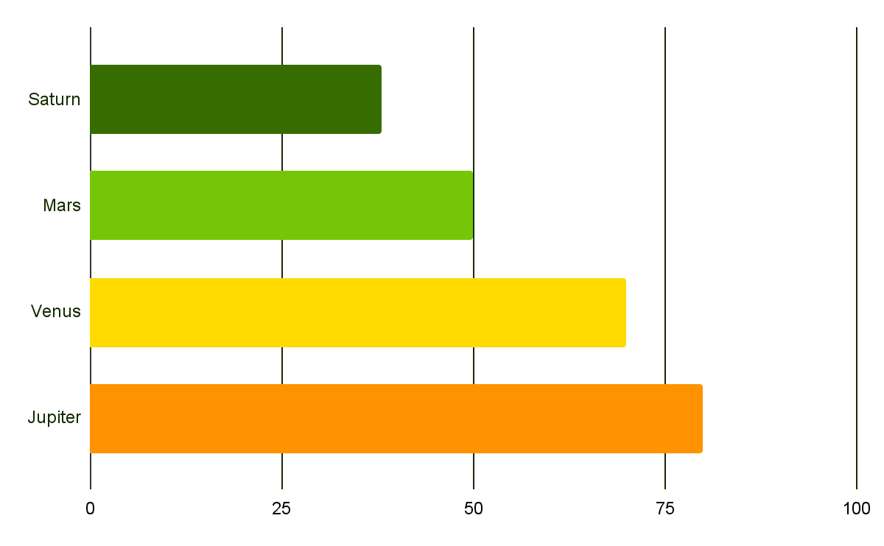
SOLAR ENERGY INFOGRAPHICS
JUPITER
SATURN
Jupiter is a huge gas giant
Saturn is a gas giant with rings
VENUS
MARS
Venus has a beautiful name
Mars is very cold, not hot
Follow the link in the graph to modify its data and then paste the new one here. For more info, click here

Slide 14
SOLAR ENERGY INFOGRAPHICS
 | DESCRIPTION
MERCURY | Mercury is the smallest planet of them all Neptune is the farthest planet from the Sun
VENUS | Venus is the second planet from the Sun Saturn is not the only planet with rings
PLUTO | Pluto is now considered a dwarf planet Saturn is the ringed planet and a gas giant
EARTH | Earth is the planet we live on The Moon is Earth’s only natural satellite

Slide 15
SOLAR ENERGY INFOGRAPHICS
STEP 1
STEP 2
STEP 3
STEP 4
JUPITER
VENUS
SATURN
MARS
Jupiter is a huge gas giant
Venus has a beautiful name
Saturn is a gas giant with rings
Mars is very cold, not hot

Slide 16
SOLAR ENERGY INFOGRAPHICS
EARTH
1
Earth is the third planet from the Sun and the only one that harbors life
MERCURY
2
Mercury is the closest planet to the Sun and the smallest one
VENUS
3
Venus is the second planet from the Sun. It’s terribly hot, even hotter than Mercury

Slide 17
SOLAR ENERGY INFOGRAPHICS
SOLAR ENERGY
JUPITER
MERCURY
MARS
VENUS
Jupiter is a huge gas giant
Mercury is the smallest planet
Despite being red, Mars is very cold
Venus has a beautiful name

Slide 18
SOLAR ENERGY INFOGRAPHICS
1
MERCURY
Mercury is the closest planet to the Sun
2
JUPITER
Jupiter is the biggest planet of them all
SOLAR ENERGY
3
SATURN
It’s composed of hydrogen and helium
4
MARS
Despite being red, Mars is very cold

Slide 19
SOLAR ENERGY INFOGRAPHICS
JUPITER
VENUS
SATURN
MARS
Jupiter is a huge gas giant
Venus has a beautiful name
Saturn is a gas giant with rings
Mars is very cold, not hot
1
2
3
4

Slide 20
SOLAR ENERGY INFOGRAPHICS
SATURN
EARTH
Saturn is not the only planet with rings
Earth is the planet with life
JUPITER
VENUS
Jupiter is the biggest planet of them all
Venus is the second planet from the Sun
MARS
MERCURY
Mars is actually a cold place
Mercury is a
small planet

Slide 21
SOLAR ENERGY INFOGRAPHICS
3/5
4/5
5/5
SATURN
JUPITER
MARS
Saturn is not the only planet with rings
Jupiter is the biggest planet of them all
Despite being red, Mars is very cold, not hot

Slide 22
SOLAR ENERGY INFOGRAPHICS
TASKS | JAN | FEB | MAR | APR | JUN
TASK 1
TASK 2
TASK 3
TASK 4
Mars is actually a cold place
Jupiter is a huge gas giant
Mercury is a small planet
Venus has a beautiful name

Slide 23
SOLAR ENERGY INFOGRAPHICS
EARTH
25%
Earth is the only planet known to harbor life
VENUS
50%
Venus is the second planet from the Sun
MERCURY
75%
Mercury is the smallest planet of them all

Slide 24
SOLAR ENERGY INFOGRAPHICS
SOLAR ENERGY
Mercury is the closest planet to the Sun
Jupiter is the biggest planet of them all
Venus is the second planet from the Sun
Despite being red, Mars is very cold
Earth is the only planet known to harbor life
Saturn is not the only planet with rings

Slide 25
SOLAR ENERGY INFOGRAPHICS
SOLAR ENERGY
1 | 2 | 3 | 4 | 5
JUPITER | MERCURY | MARS | VENUS | NEPTUNE
Jupiter is a huge gas giant | Mercury is a small planet | Mars is actually a very cold place | Venus has a beautiful name | Neptune is far away from us

Slide 26
SOLAR ENERGY INFOGRAPHICS
JUPITER
VENUS
Jupiter is a huge gas giant
Venus has a beautiful name
MARS
MERCURY
Mars is actually a cold place
Mercury is a
small planet

Slide 27
SOLAR ENERGY INFOGRAPHICS
JUPITER
SATURN
Jupiter is a huge gas giant
Saturn is a gas giant with rings
01
02
03
04
VENUS
MARS
Venus has a beautiful name
Mars is very cold, not hot

Slide 28
SOLAR ENERGY INFOGRAPHICS
SOLAR ENERGY
JUPITER
MERCURY
MARS
VENUS
Jupiter is a huge gas giant
Mercury is a
small planet
Despite being red, Mars is very cold
Venus has a beautiful name

Slide 29
SOLAR ENERGY INFOGRAPHICS
1
JUPITER
Jupiter is a huge gas giant
2
VENUS
Venus has a beautiful name
3
MERCURY
Mercury is a small planet

Slide 30
SOLAR ENERGY INFOGRAPHICS
25%
50%
MERCURY
JUPITER
Mercury is a
small planet
Jupiter is the biggest planet of them all
75%
90%
SATURN
VENUS
Saturn is not the only planet with rings
Venus is the second planet from the Sun

Slide 31
SOLAR ENERGY INFOGRAPHICS
JUPITER
VENUS
SATURN
MARS
1
2
3
4
Jupiter is a huge gas giant
Venus has a beautiful name
Saturn is a gas giant with rings
Mars is very cold, not hot

Slide 32
SOLAR ENERGY INFOGRAPHICS
1
MARS
Mars is actually a cold place
2
Saturn has rings
SATURN
3
VENUS
Venus has a beautiful name
4
Mercury is a small planet
MERCURY

Slide 33
Instructions for use
If you have a free account, in order to use this template, you must credit Slidesgo in your final presentation. Please refer to the next slide to read the instructions for premium users.
As a Free user, you are allowed to:
- Modify this template.
- Use it for both personal and commercial projects.
You are not allowed to:
- Sublicense, sell or rent any of Slidesgo Content (or a modified version of Slidesgo Content).
- Distribute Slidesgo Content unless it has been expressly authorized by Slidesgo.
- Include Slidesgo Content in an online or offline database or file.
- Offer Slidesgo templates (or modified versions of Slidesgo templates) for download.
- Acquire the copyright of Slidesgo Content.
For more information about editing slides, please read our FAQs or visit our blog:
https://slidesgo.com/faqs and https://slidesgo.com/slidesgo-school

Slide 34
Instructions for use (premium users)
As a Premium user, you can use this template without attributing Slidesgo.
You are allowed to:
Modify this template.
Use it for both personal and commercial purposes.
Share this template in an editable format with people who are not part of your team.
You are not allowed to:
Sublicense, sell or rent this Slidesgo Template (or a modified version of this Slidesgo Template).
Distribute this Slidesgo Template (or a modified version of this Slidesgo Template) or include it in a database or in any other product or service that offers downloadable images, icons or presentations that may be subject to distribution or resale.
Use any of the elements that are part of this Slidesgo Template in an isolated and separated way from this Template.
Register any of the elements that are part of this template as a trademark or logo, or register it as a work in an intellectual property registry or similar.
For more information about editing slides, please read our FAQs or visit our blog:
https://slidesgo.com/faqs and https://slidesgo.com/slidesgo-school

Slide 35
Infographics
You can add and edit some infographics to your presentation to present your data in a visual way.
Choose your favourite infographic and insert it in your presentation using Ctrl C + Ctrl V or Cmd C + Cmd V in Mac.
Select one of the parts and ungroup it by right-clicking and choosing “Ungroup”.
Change the color by clicking on the paint bucket.
Then resize the element by clicking and dragging one of the square-shaped points of its bounding box (the cursor should look like a double-headed arrow). Remember to hold Shift while dragging to keep the proportions.
Group the elements again by selecting them, right-clicking and choosing “Group”.
Repeat the steps above with the other parts and when you’re done editing, copy the end result and paste it into your presentation.
Remember to choose the “Keep source formatting” option so that it keeps the design. For more info, please visit our blog.

